Slide 1
Chapter 10
Keyboard Operations

Slide 2
Scan Code
Each key has a scan code, beginning with 01 for ESC.
By means of scan code, a program may determine the source of
any keystroke.
For example, a program uses INT 16H function 10H to request input
of one character. If the letter A is pressed, the operation delivers
AH = scan code for letter A, 1EH
AL = ASCII code for A, 41H
You can test AL if it contains 00H (Home, F1,…, F11, F12) or
E0H for an extended function keys (duplicate control keys: Home, PageUp.)
such as F1 and Shift+F1, Home, End, Arrow, Del, Ins, PgUp, PgDn.

Slide 3
In the following example, If a user presses the HOME key ( scan code,
47H), the cursor is set to row 0, column 0:
MOV AH, 10H ;request keyboard input
INT 16H ;call interrupt service
CMP AL, 00H ;extended function?
JE L30 ;yes, bypass
CMP AL, 0E0H ;extended function?
JNE exit ;no, exit
L30: CMP AH, 47H ;scan code for HOME?
JNE exit ;no, exit
MOV AH,02H ;request
MOV BH, 00 ; set cursor (BH: page number)
MOV DX, 00 ; to 00:00 (DH = row, DL = column)
INT 10H ;call interrupt service

Slide 4
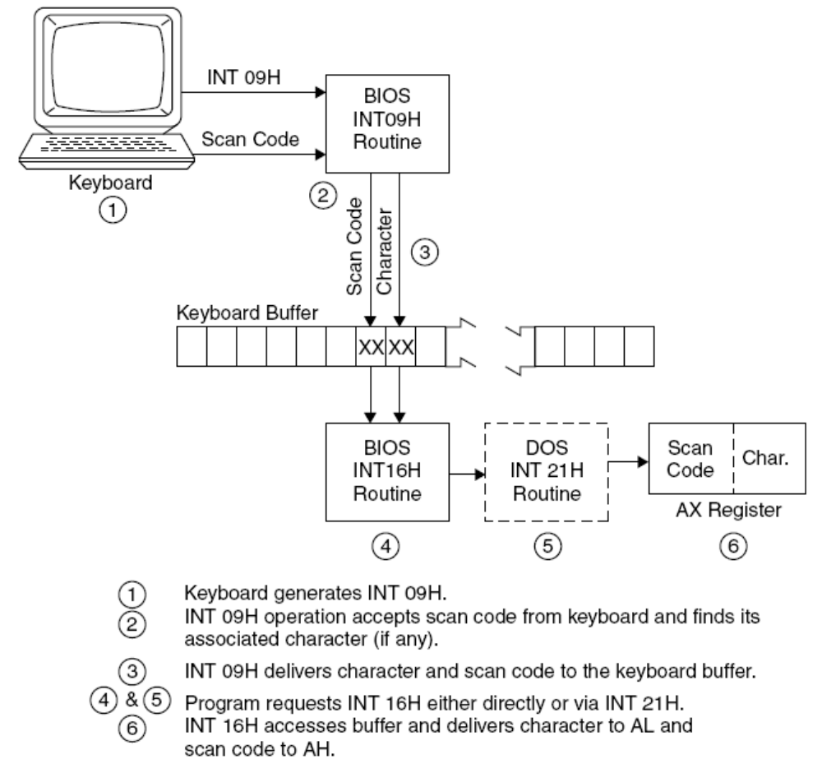

Slide 5
Keyboard Buffer
41AH current head of the buffer, the next position for INT 16H to get a
character and send it to the program in AX.
41CH current tail of the buffer, the next position for INT 09H to store a
character entered from the keyboard.
41EH beginning of the keyboard buffer itself, contains 16 words
When the user types a character, INT 09H advances the tail in the buffer.
When INT 16H reads a character, it advances the head.
The head chases the tail until the buffer is empty; the head and the tail
are at the same address when the buffer is empty.

Slide 6
In the following example, both the head and the tail are at 41EH initially.
A user keys in “abc<Enter>”, which the INT 09H stores as follows:
the tail at 426H by INT 09H
a 1EH b 30H c 2EH <Ent> E0H …
41E 41F 420 421 422 423 424 425 426
First INT 16H: read a and its scan code and advances the head to 420H
Second INT 16H: read b and its scan code and advances the head to 422H
…
INT 16H four times: all characters read and the head is at 426H.

Slide 7
When you key in 15 characters (fghijklmnopqrs<Enter>), the buffer is full,
and the tail is immediately behind the head.
INT 09H accepts only 15 characters at most.
r s <Ent> * f g h i j k l m n o p q
41E 420 422 424 426 428 42A 43A 43C
At this point, INT 09H does not accept any more typed characters.

Slide 8
本章介紹的INT 21H功能
07H: 直接鍵盤輸入,螢幕無回應
08H:鍵盤輸入,螢幕無回應
0AH: 緩衝鍵盤輸入
0BH: 檢查鍵盤狀況
0CH: 清緩衝區, 呼叫另一鍵盤輸入功能
本章介紹的INT 16H功能
03H: 設定 Typematic 速率
05H: 寫到鍵盤 (模擬輸入)
10H: 讀一個字
11H:檢查是否有按鍵輸入
12H: 取目前的shift狀況

Slide 9
鍵盤的按鍵分三類:
標準字元: 字母、數字和標點符號
延伸功能鍵: <F1>, <F2>, …, <Del>, <Ins>, …
控制鍵: <alt>, <ctrl> 和 <shift>
最早的PC只有83個按鍵, 後來增加單獨的
游標控制鍵和其它, 增加到104個鍵
INT 21H function 08H
鍵盤輸入, 螢幕無回應
等待鍵盤輸入; 回來時, AL放按鍵的ASCII碼
若是特殊鍵, AL=0; 應再呼叫一次, 可得Scan code
INT 21H function 0BH
檢查鍵盤狀況
回來時, AL=0FFH 表示user有按鍵; A=0 表示user無按鍵
須呼叫 function 08 (或其它)輸入字碼

Slide 10
INT 21H function 0CH
清緩衝區, 並呼叫另一鍵盤輸入功能
MOV AH,0CH
MOV AL, function
INT 21H
AL的 function值: 01H, 06H, 07H, 08H, 0AH
INT 16H function 03H
設定 Typematic 速率
MOV AH,03H
MOV AL,05H
MOV BH,repeat_delay
MOV BL,repeat_rate
INT 16H
BH: 0=1/4秒, 1=1/2秒 (Default), 2=3/4秒, 3=1秒
BL: 0 到 31 (最慢)

Slide 11
INT 16H function 05H
寫到鍵盤 (模擬輸入)
插入字到鍵盤緩衝區
CH放ASCII碼, CL放掃描碼
INT 16H function 10H
讀一個字
檢查鍵盤緩衝區。若有字, ASCII碼放在AL, 掃描碼放在AH。
若沒有字, 則等待按鍵輸入
特殊鍵沒有ASCII碼, 只有掃描碼。讀到的ASCII碼是0或0E0H
INT 16H function 11H
檢查是否有按鍵輸入
• 回來時, ZF=0表示有按鍵輸入; ASCII碼放在AL, 掃描碼放在AH
• 仍須呼叫讀鍵盤的功能讀入按鍵值
• 若未使用讀鍵盤的功能呼叫讀入按鍵值, 按鍵值仍放在緩衝區內

Slide 12
INT 16H function 12H
取目前的shift狀況
將BIOS資料區40:17H和40:18H的內容讀到AL和AH
AH的位元:
  7: SysReq 按下, 6: Capslock 按下,
  5: Numlock 按下, 4: ScrollLock 按下
  3: 右 Alt 按下, 2: 右 Ctrl 按下,
  1:左 Alt 按下, 0:左Ctrl 按下
AL的位元:
  7: Insert active, 6: Capslock active,
  5: Numlock active, 4: ScrollLock active
  3: 右 Alt 按下, 2: 右 Ctrl 按下,
  1:左 Shift 按下, 0: 右 Shift 按下
例子: 檢查左或右邊的 Shift 是否被按下
MOV AH,12H
INT 16H
AND AL,00000011B
JZ exit

Slide 13
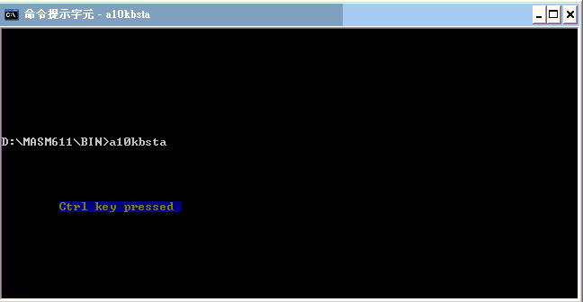
Testing Alt, Shift, & Ctrl Status
The INT 09H handles the keyboard status bytes at 40:17H, 40:18H,
and 40:96H in the BIOS Data Area. When you press Shift, Ctrl, or ALT,
the BIOS routine sets the appropriate bit to 1, and clears it to 0 when
you release the key.

Slide 14
INT 16h, function 12h (18) Get Extended Shift Status
It returns the current keyboard shift status. This service is provided to support the enhanced (101/102-key) keyboard.
On entry: AH 12h
Returns: AL Shift status
AH Extended shift status
------------------------------------------------------------------
Shift Status (AL) ⬄ BIOS資料區40:17H
bits: 7 6 5 4 3 2 1 0
1 . . . . . . . Insert locked
. 1 . . . . . . Caps Lock locked
. . 1 . . . . . Num Lock locked
. . . 1 . . . . Scroll Lock locked
. . . . 1 . . . Alt key is pressed
. . . . . 1 . . Ctrl key is pressed
. . . . . . 1 . Left Shift key is pressed
. . . . . . . 1 Right Shift key is
Extended Shift Status (AH) ⬄ BIOS資料區40:18H
bits: 7 6 5 4 3 2 1 0
1 . . . . . . . Sys Req key is pressed
. 1 . . . . . . Caps Lock key is pressed
. . 1 . . . . . Num Lock key is pressed
. . . 1 . . . . Scroll Lock key is pressed
. . . . 1 . . . Right Alt key is pressed
. . . . . 1 . . Right Ctrl key is is pressed
. . . . . . 1 . Left Alt key is pressed
. . . . . . . 1 Left Ctrl key is pressed

Slide 15
BIOS Data Areas at 40[0]H:
Keyboard Data Area1 (40:17H)
You can use INT 16h function 02h to get shift status.
INT 16h, function 02h (2) Get Shift Status
It returns the current keyboard shift status.
On entry: AH 02h
Returns: AL Shift status
--------------------------------------------------------------------------
Shift Status (AL)
7 6 5 4 3 2 1 0
1 . . . . . . . Insert locked
. 1 . . . . . . Caps Lock locked
. . 1 . . . . . Num Lock locked
. . . 1 . . . . Scroll Lock locked
. . . . 1 . . . Alt key is pressed
. . . . . 1 . . Ctrl key is pressed
. . . . . . 1 . Left Shift key is pressed
. . . . . . . 1 Right Shift key is pressed

Slide 16
TITLE A10KBSTA (EXE) Testing Alt, Shift, & Ctrl Status
.MODEL SMALL
.STACK 64
.DATA
BIODATA SEGMENT AT 40H ;Locate BIOS data area
ORG 17H ; and
KBSTATE DB ? ; status byte
BIODATA ENDS
CR EQU 0DH ;Carriage return
LF EQU 0AH ;Line feed
ALTKEY DB 'Alt key pressed ', CR, LF
CTRLKEY DB 'Ctrl key pressed ', CR, LF
SHIFTKEY DB 'Shift key pressed', CR, LF
.286 ; ------------------------------------------------------
.CODE
A10MAIN PROC FAR
MOV AX,BIODATA ;Initialize segment address
MOV ES,AX ; of BIODATA in ES

Slide 17
A20: MOV AH,10H ;Request keyboard entry
INT 16H
CMP AL,0DH ;User requests end?
JE A90 ; yes, exit
MOV BL,ES:KBSTATE ;Get keyboard status byte
TEST BL,00000011B ;Shift + char pressed?
JZ A30 ; no, bypass
LEA BP,SHIFTKEY ;Request display
CALL D10DISPLY ; shift message
A30: TEST BL,00000100B ;Ctrl + char pressed?
JZ A40 ; no, bypass
LEA BP,CTRLKEY ;Request display
CALL D10DISPLY ; ctrl message
A40: TEST BL,00001000B ;Alt + char pressed?
JZ A20 ; no, bypass
LEA BP,ALTKEY ;Request display
CALL D10DISPLY ; alt message
JMP A20 ;Repeat
A90: MOV AX,4C00H ;End processing
INT 21H
A10MAIN ENDP

Slide 18
; Display message for Alt, Ctrl, and
; Shift if key is pressed.
D10DISPLY PROC NEAR ;BP set on entry
PUSHA ;Preserve registers
PUSH ES
MOV AX, @data ;Set up for ES:BP
MOV ES,AX ; for address of data
MOV AX,1301H ;Request display
MOV BX,0016H ;Page and attribute
MOV CX,17 ;Length of string
MOV DX,1008H ;Row and column
INT 10H
POP ES
POPA ;Restore registers
RET
D10DISPLY ENDP
END A10MAIN

Slide 19
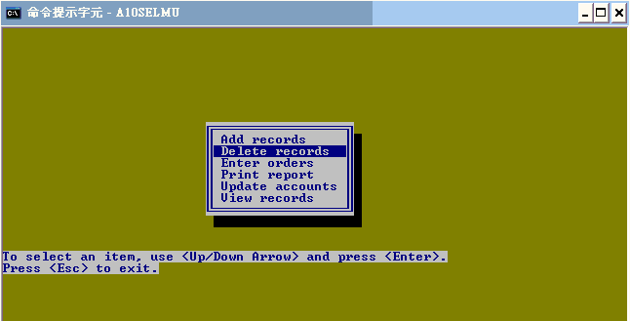
Program: Selecting from a Menu

Slide 20
TITLE A10SELMU (EXE) Select item from menu
.MODEL SMALL
.STACK 64
; -----------------------------------------------------
.DATA
TOPROW EQU 08 ;Top row of menu
BOTROW EQU 15 ;Bottom row of menu
LEFCOL EQU 26 ;Left column of menu
ATTRIB DB ? ;Screen attribute
ROW DB 00 ;Screen row
SHADOW DB 19 DUP(0DBH) ;Shadow characters
MENU DB 0C9H, 17 DUP(0CDH), 0BBH
DB 0BAH, ' Add records ', 0BAH
DB 0BAH, ' Delete records ', 0BAH
DB 0BAH, ' Enter orders ', 0BAH
DB 0BAH, ' Print report ', 0BAH
DB 0BAH, ' Update accounts ', 0BAH
DB 0BAH, ' View records ', 0BAH
DB 0C8H, 17 DUP(0CDH), 0BCH
PROMPT DB 'To select an item, use <Up/Down Arrow>'
DB ' and press <Enter>.'
DB 13, 10, 'Press <Esc> to exit.'
.386 ; ------------------------------------------------

Slide 21
.CODE
A10MAIN PROC FAR
MOV AX, @data ;Initialize segment
MOV DS,AX ; registers
MOV ES,AX
CALL Q10CLEAR ;Clear screen
MOV ROW,BOTROW+4 ;Set row
A20:
CALL B10MENU ;Display menu
MOV ROW,TOPROW+1 ;Set row to top item
MOV ATTRIB,16H ;Set reverse video
CALL D10DISPLY ;Highlight current menu line
CALL C10INPUT ;Provide for menu selection
CMP AL,1BH ;Escape key pressed?
JNE A20 ; no, continue
MOV AX,0600H ; yes, end
CALL Q10CLEAR ;Clear screen
MOV AX,4C00H ;End of processing
INT 21H
A10MAIN ENDP

Slide 22
; Display shadow box, next menu on top, then prompt
; -------------------------------------------------
B10MENU PROC NEAR
PUSHA ;Preserve general registers
MOV AX,1301H ;Request display shadow box
MOV BX,0060H ;Page and attribute
LEA BP,SHADOW ;Shadow characters
MOV CX,19 ;19 characters
MOV DH,TOPROW+1 ;Top row of shadow
MOV DL,LEFCOL+1 ;Left column of shadow
B20: INT 10H
INC DH ;Next row
CMP DH,BOTROW+2 ;All rows displayed?
JNE B20 ; no, repeat
MOV ATTRIB,71H ;Blue on white
MOV AX,1300H ;Request display menu
MOVZX BX,ATTRIB ;Page and attribute
LEA BP,MENU ;Menu line
MOV CX,19 ;Length of line
MOV DH,TOPROW ;Row
MOV DL,LEFCOL ;Column

Slide 23
B30:
INT 10H
ADD BP,19 ;Next menu line
INC DH ;Next row
CMP DH,BOTROW+1 ;All rows displayed?
JNE B30 ; no, repeat
MOV AX,1301H ;Request display prompt
MOVZX BX,ATTRIB ;Page and attribute
LEA BP,PROMPT ;Prompt line
MOV CX,79 ;Length of line
MOV DH,BOTROW+4 ;Screen row,
MOV DL,00 ; column
INT 10H
POPA ;Restore registers
RET
B10MENU ENDP
; Accept keyboard request, Arrow and Enter
; to select menu line, Esc to exit:
; ----------------------------------------

Slide 24
C10INPUT PROC NEAR
PUSHA ;Preserve general registers
C20: MOV AH,10H ;Request one character
INT 16H ; from keyboard
CMP AH,50H ;Down arrow?
JE C30
CMP AH,48H ;Up arrow?
JE C40
CMP AL,0DH ;Enter key?
JE C90
CMP AL,1BH ;Escape key?
JE C90
JMP C20 ;None, retry
C30: MOV ATTRIB,71H ;Blue on white
CALL D10DISPLY ;Set old line to normal video
INC ROW ;Increment for next row
CMP ROW,BOTROW-1 ;Past bottom row?
JBE C50 ; no, ok
MOV ROW,TOPROW+1 ; yes, reset
JMP C50

Slide 25
C40: MOV ATTRIB,71H ;Blue on white
CALL D10DISPLY ;Set old line to normal video
DEC ROW
CMP ROW,TOPROW+1 ;Below top row?
JAE C50 ; no, ok
MOV ROW,BOTROW-1 ; yes, reset
C50: MOV ATTRIB,17H ;White on blue
CALL D10DISPLY ;Set new line to reverse video
JMP C20
C90: POPA ;Restore registers
RET
C10INPUT ENDP
; Set menu line to highlight (if
; selected) or normal (if not selected):
; -------------------------------------
D10DISPLY PROC NEAR
PUSHA ;Preserve general registers
MOVZX AX,ROW ;Row tells which line to set
SUB AX,TOPROW
IMUL AX,19 ;Multiply by length of line
LEA SI,MENU+1 ; for selected menu line
ADD SI,AX

Slide 26
MOV AX,1300H ;Request display
MOVZX BX,ATTRIB ;Page and attribute
MOV BP,SI ;Character string
MOV CX,17 ;Length of string
MOV DH,ROW ;Row
MOV DL,LEFCOL+1 ;Column
INT 10H
POPA ;Restore registers
RET
D10DISPLY ENDP
; Clear screen:
; ------------
Q10CLEAR PROC NEAR
PUSHA ;Preserve general registers
MOV AX,0600H
MOV BH,61H ;Blue on brown
MOV CX,0000 ;Full screen
MOV DX,184FH
INT 10H
POPA ;Restore registers
RET
Q10CLEAR ENDP
END A10MAIN

Slide 27
Exercise 10.1:
--------------------------------------------------------------------------------
Improve program A10KBSTA.asm such that it can respond
correctly when one or two or three of the Shift, Ctrl, Alt keys
are pressed at the same time.
You can design the format and colors of the characters
shown on the screen as you like.
****Ctrl key pressed
+Shift key pressed
+Alt key pressed

Slide 28
Exercise 10.2:
-------------------------------------------------------------------------------------
Revise A10SELMU.asm to provide for the following features:
Revise the drop shadow from full shadow:█ (DBH)
to three-quarter dots:▓ (B2H).
After the initial clearing of the screen, display a prompt that ask users to
to press <F1> for a menu screen.
When <F1> is pressed, display the menu.
Allow users to select menu items also by pressing the first character
(upper- or lowercase) of each item,
On request of an item, display a message for the particular selection,
such as “Procedure to Delete Records.”
Add a last line to the menu containing the item “Exit from program” that
allows users to end processing. You will also have to revise the menu
(procedure B10MENU) to handle the display of another row.
https://theasciicode.com.ar/ascii-control-characters/null-character-ascii-code-0.html

